Slide 1
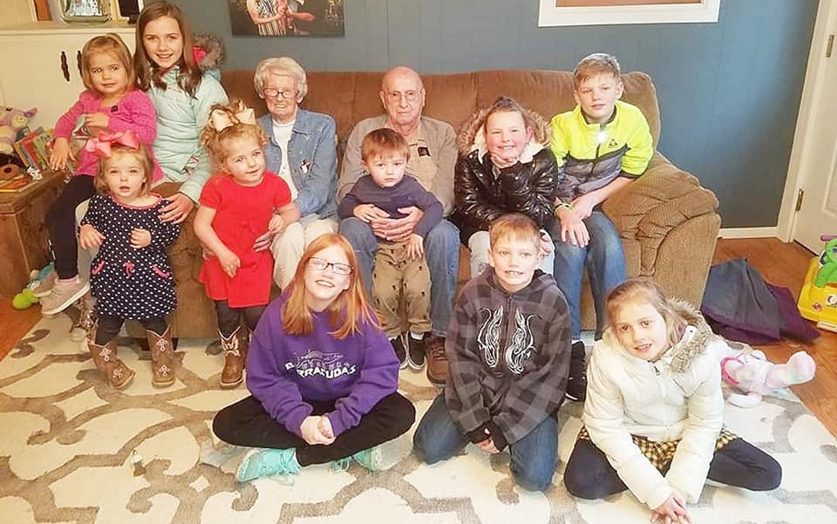

Slide 2
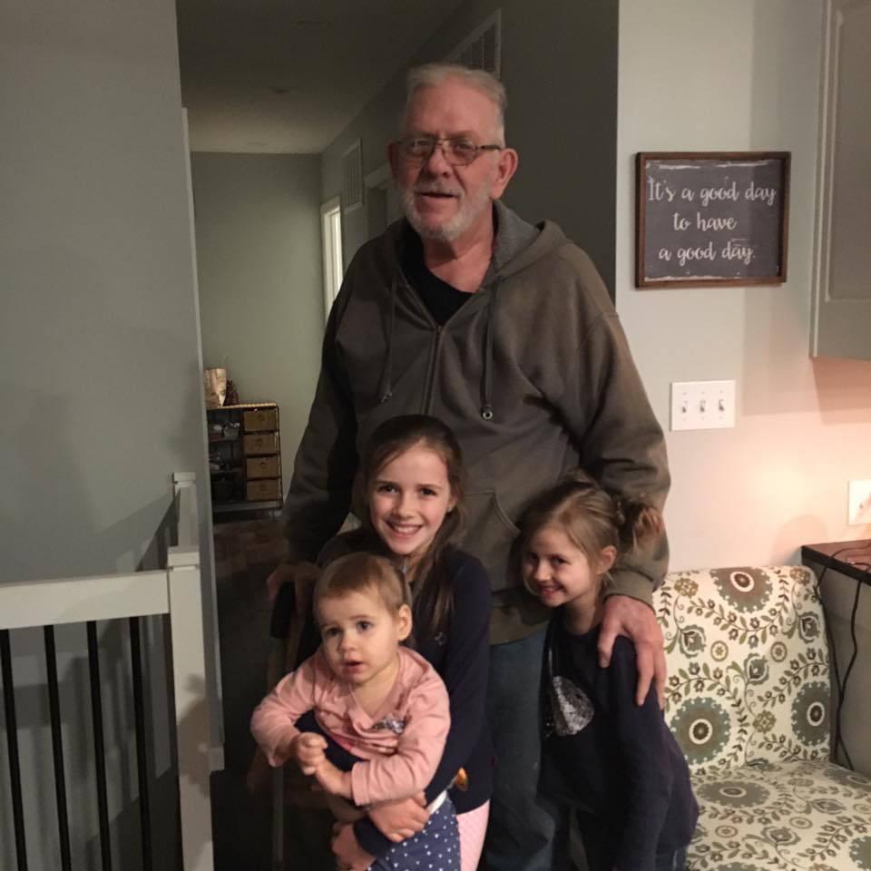

Slide 3
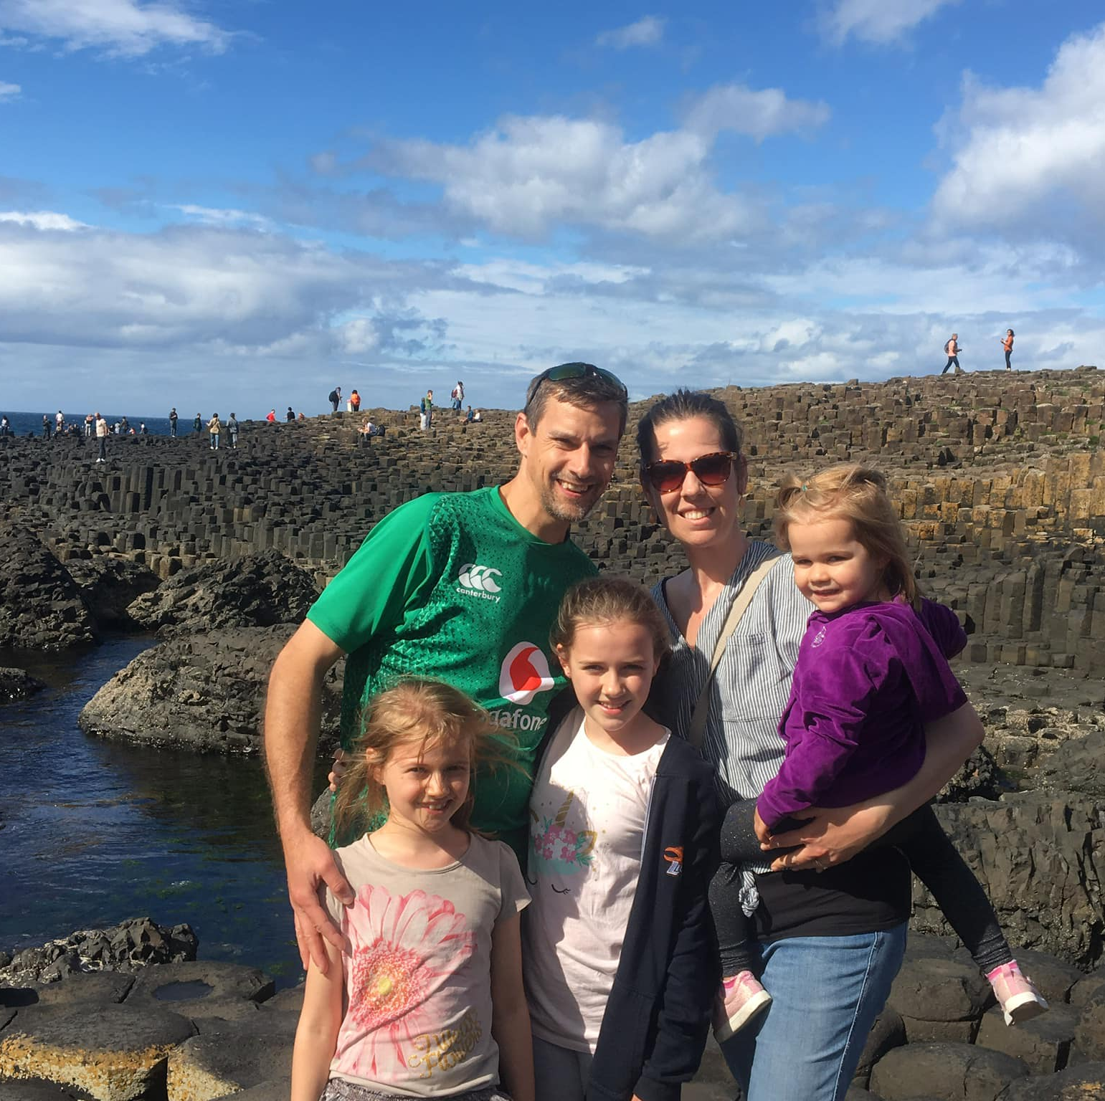
Where I Come From

Slide 4
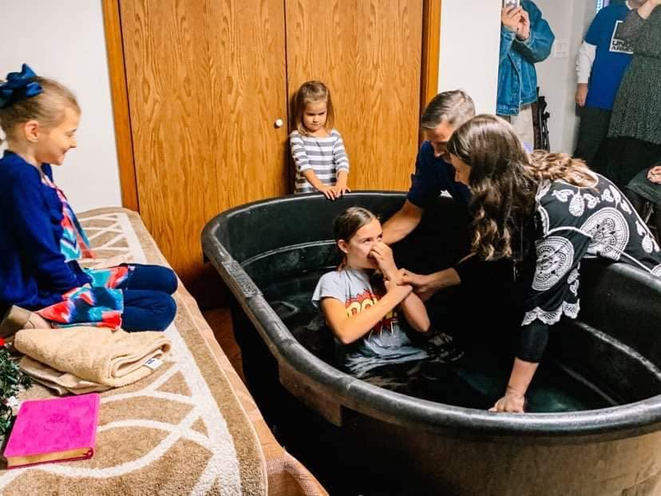
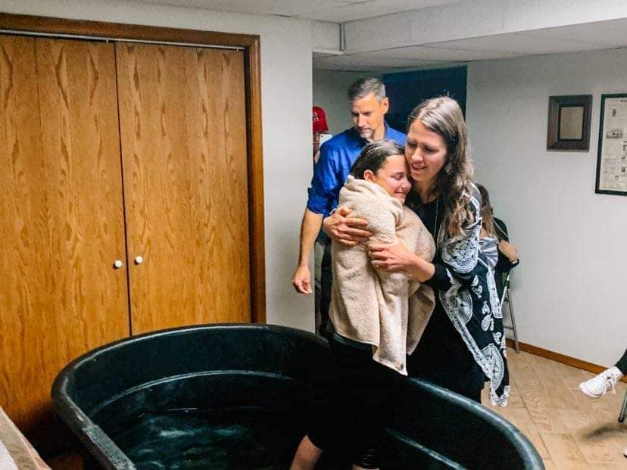

Slide 5
1. Where I Came From
Ephesians 2:11-12
¹¹ Therefore, remember that formerly you who are Gentiles by birth and called “uncircumcised” by those who call themselves “the circumcision” (which is done in the body by human hands)— ¹² remember that at that time you were separate from Christ, excluded from citizenship in Israel and foreigners to the covenants of the promise, without hope and without God in the world.

Slide 6
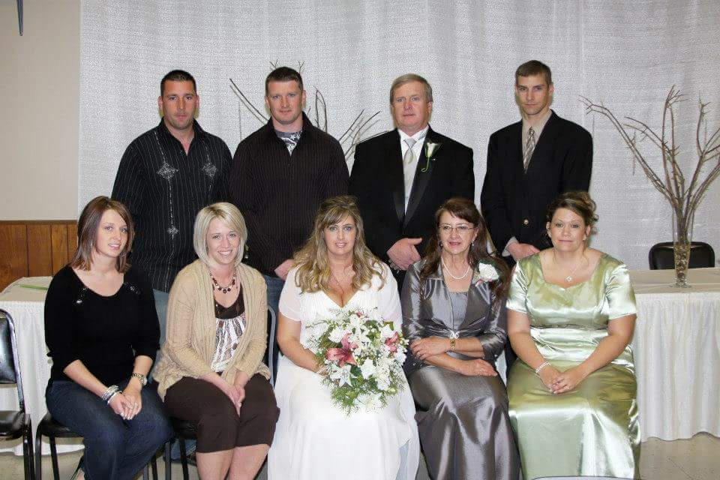
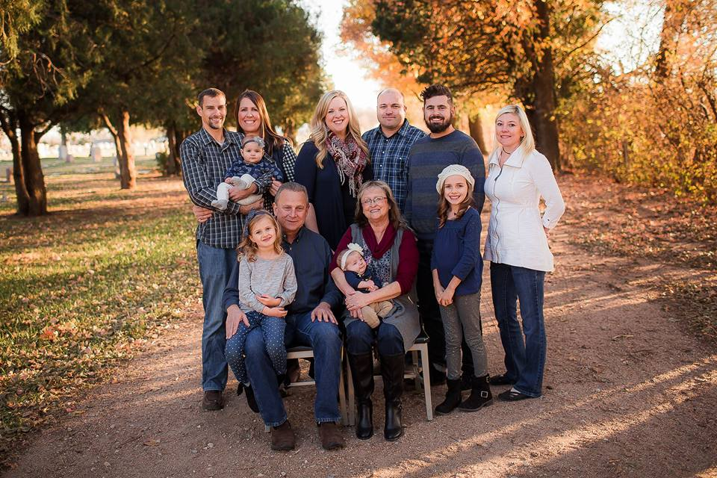

Slide 7
2. Where I Come From
Ephesians 2:13, 19-22
13 But now in Christ Jesus you who once were far away have been brought near by the blood of Christ.
19 Consequently, you are no longer foreigners and strangers, but fellow citizens with God’s people and also members of his household, 20 built on the foundation of the apostles and prophets, with Christ Jesus himself as the chief cornerstone. 21 In him the whole building is joined together and rises to become a holy temple in the Lord. 22 And in him you too are being built together to become a dwelling in which God lives by his Spirit.

Slide 8
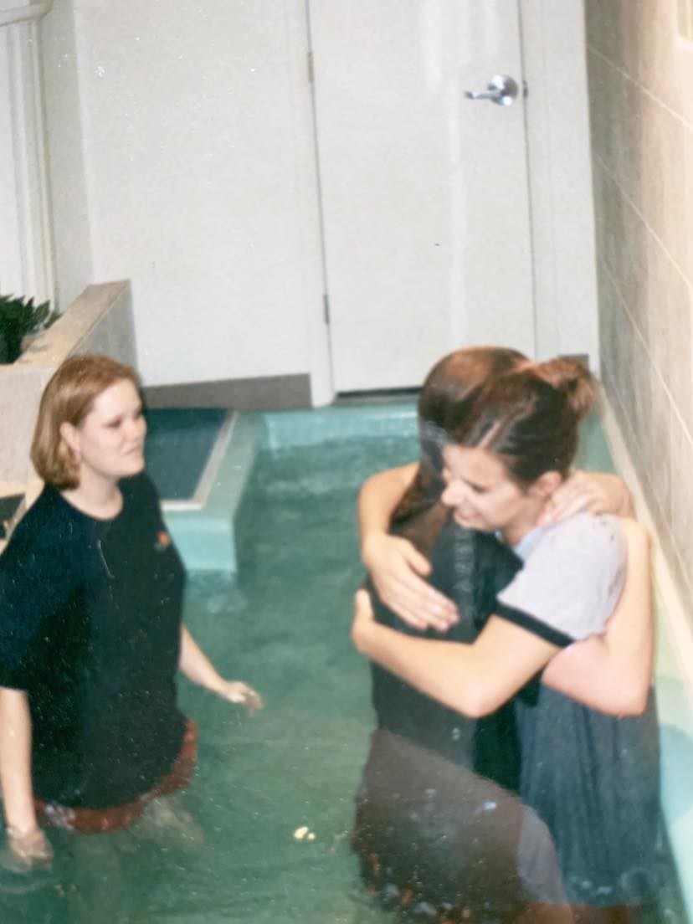

Slide 9
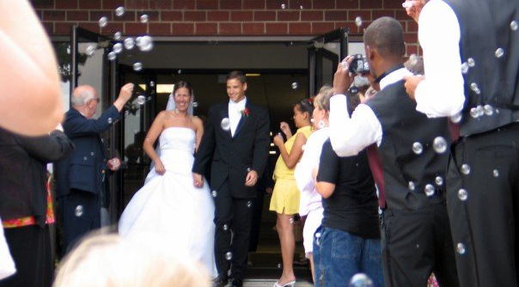

Slide 10
3. Where I am Going
Philippians 3:20-4:1
20 But our citizenship is in heaven. And we eagerly await a Savior from there, the Lord Jesus Christ, 21 who, by the power that enables him to bring everything under his control, will transform our lowly bodies so that they will be like his glorious body.
4 Therefore, my brothers and sisters, you whom I love and long for, my joy and crown, stand firm in the Lord in this way, dear friends!

Slide 11
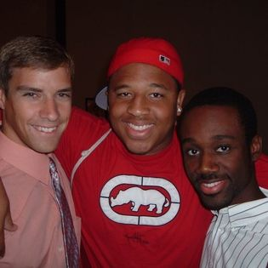
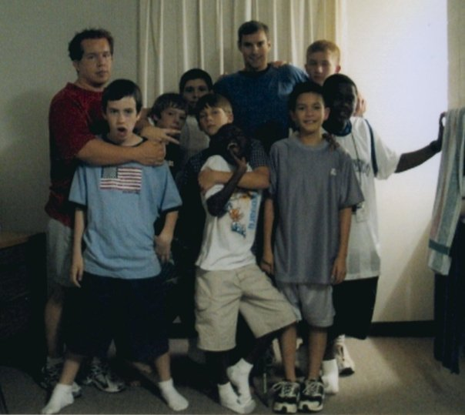
HYC
‘The Flint Cabin’
Lawrence, KS

Slide 12
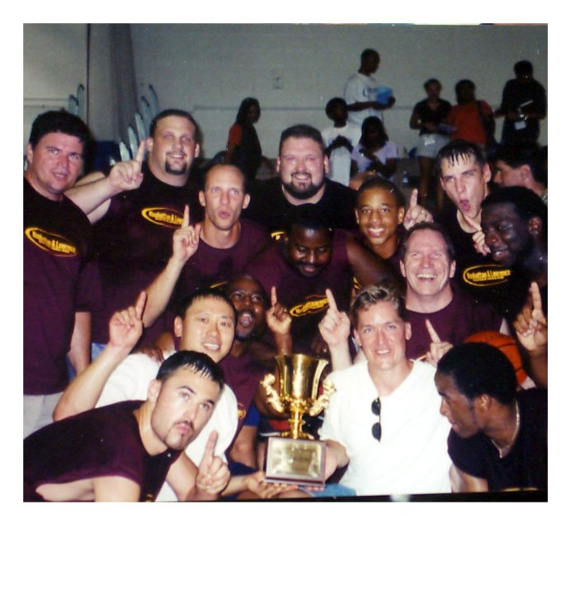
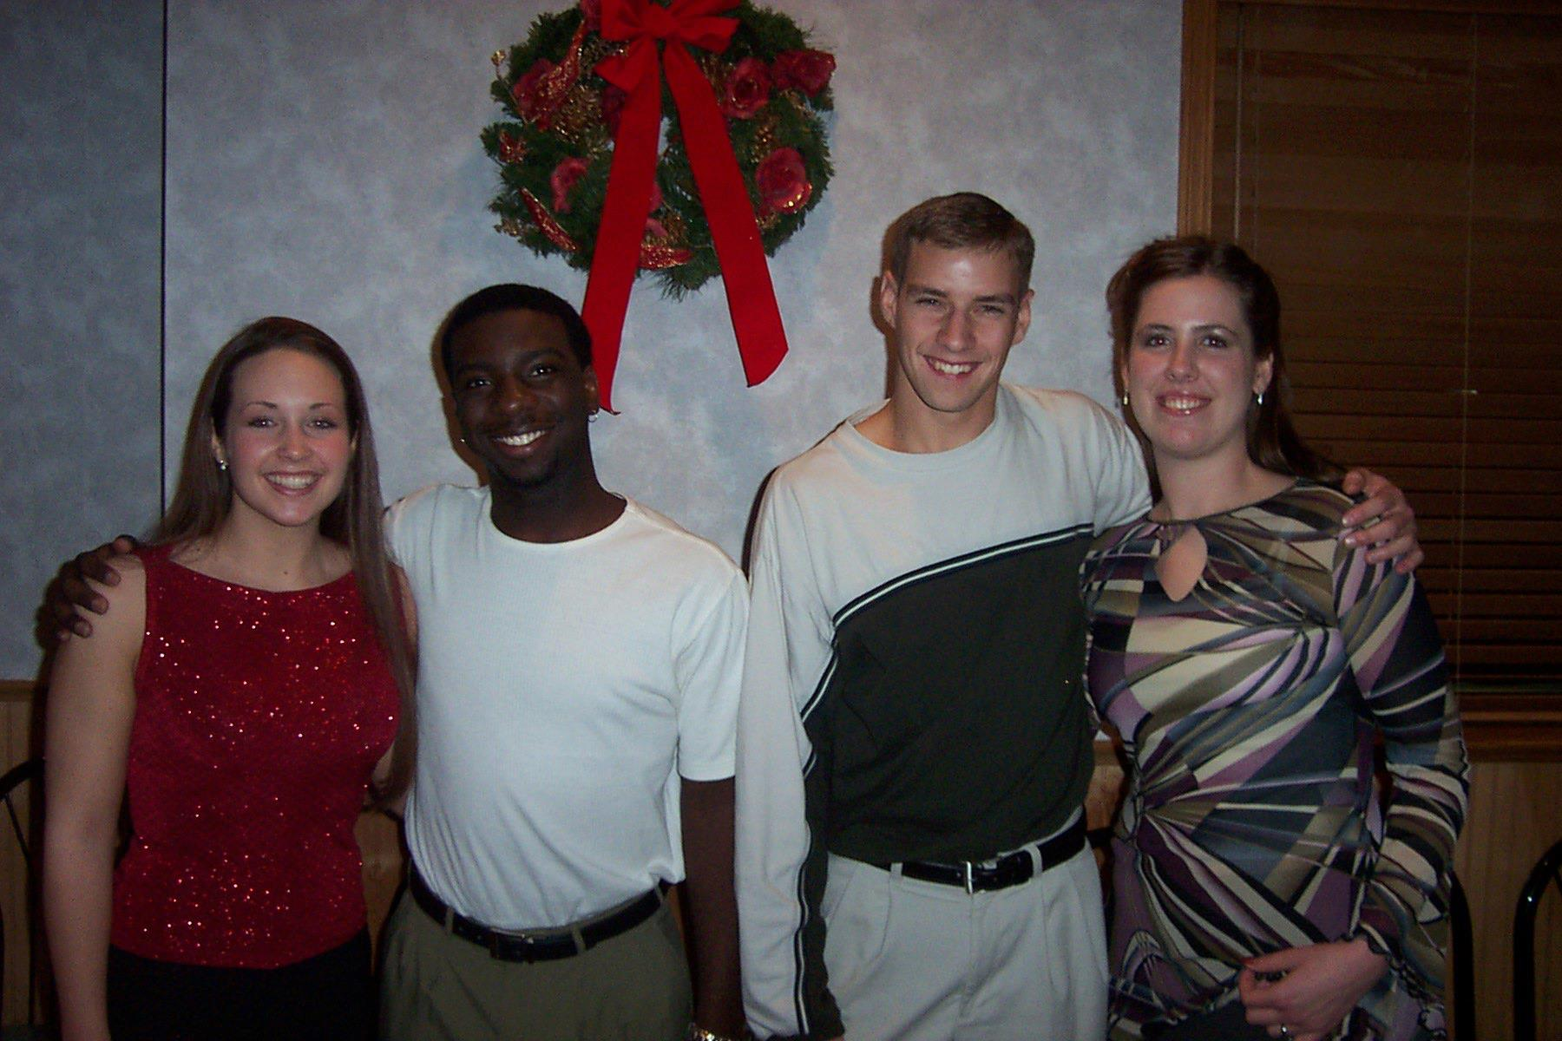
Lawrence/Manhattan, KS

Slide 13
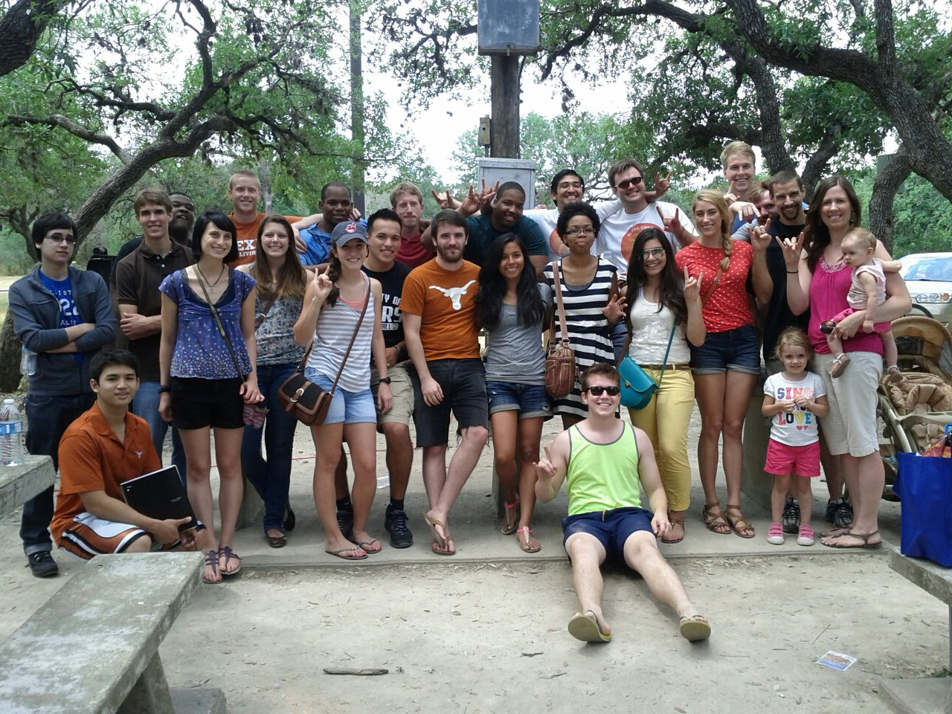
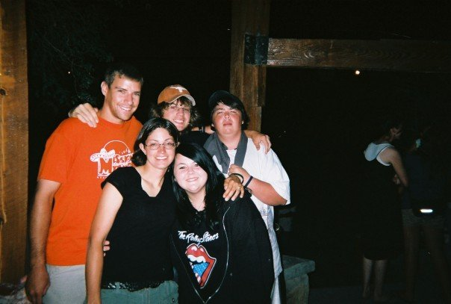
Omaha, NE
Austin, TX

Slide 14
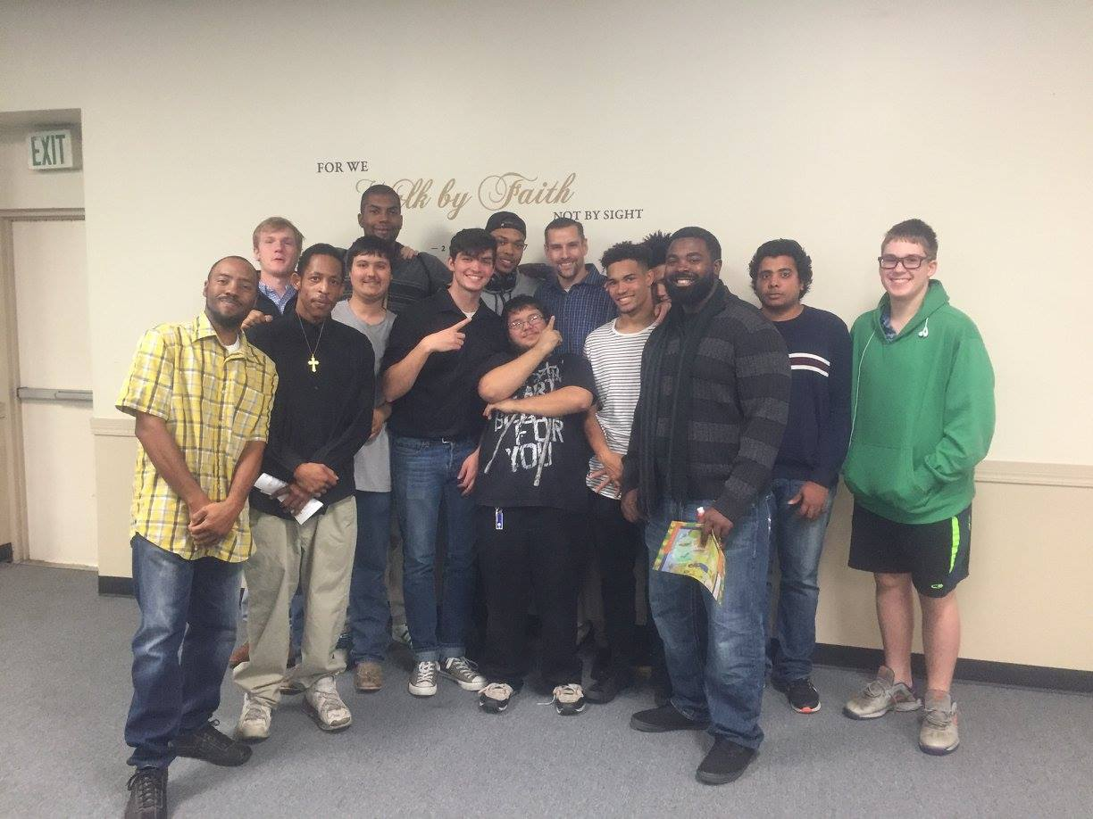
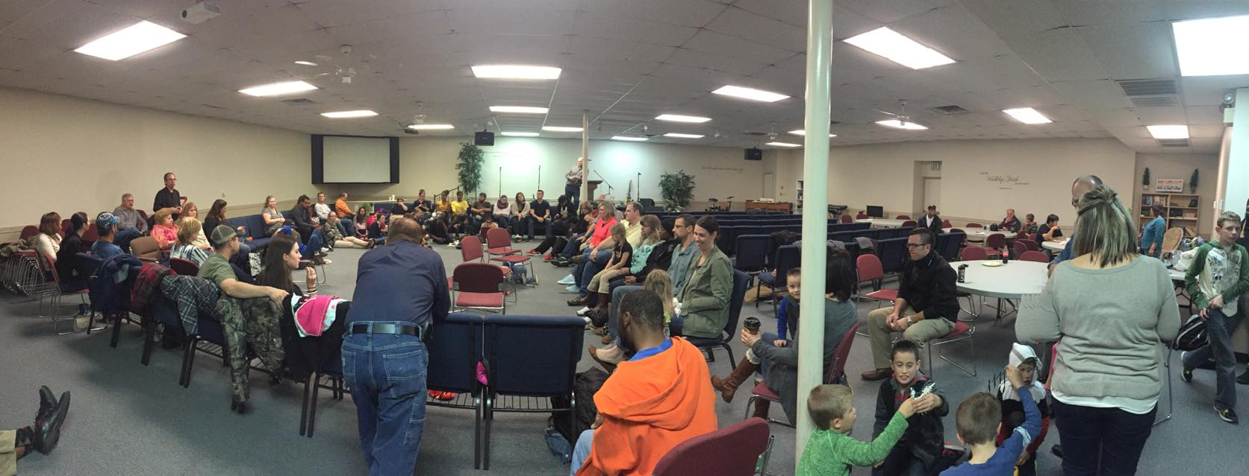
Tulsa, OK

Slide 15
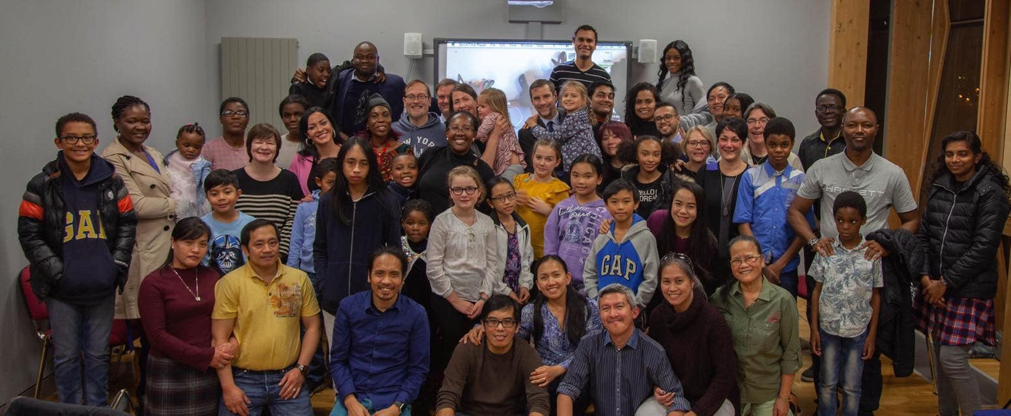
Dublin, Ireland

Slide 16
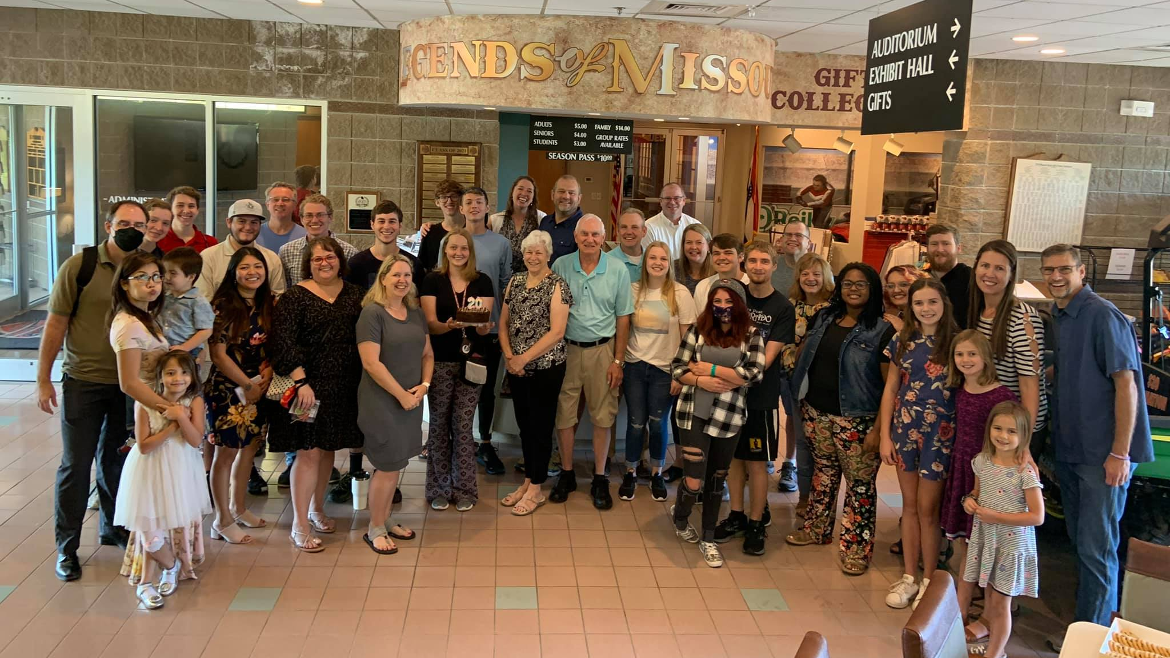
Springfield, MO

Slide 17
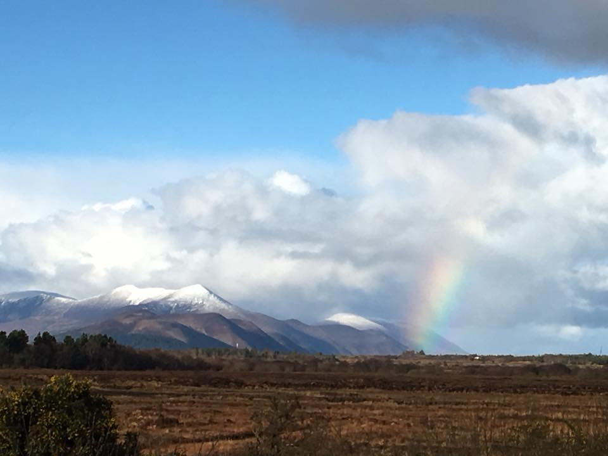
But our citizenship is in heaven.

