Slide 1
Unity
Joshua 22

Slide 2
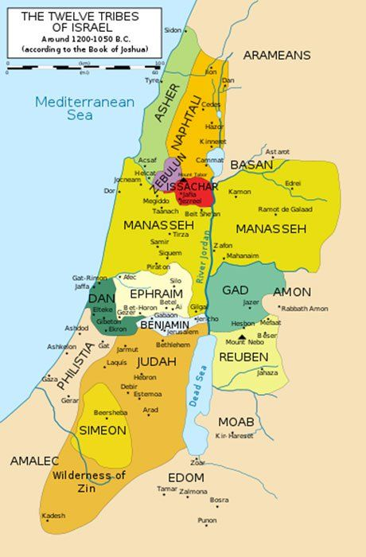
Unity
Division of the land

Slide 3
1-Faulty judgements
Ready to go to war
Catastrophic thinking

Slide 4
Here is how we think
12,000 to 60,000 thoughts per day (705 to 3,500/hour, 12 to 60/minute)
90% of thoughts are self motivated, self focused
80% of thoughts are negative... Ingratitude/guilt/shame all the way to catastrophic
95% of thoughts are repetitive

Slide 5
Here is what god says
Colossians 3:1-4
Since, then, you have been raised with Christ, set your hearts on things above, where Christ is, seated at the right hand of God. Set your minds on things above, not on earthly things. For you died, and your life is now hidden with Christ in God. When Christ, who is your life, appears, then you also will appear with him in glory.

Slide 6
Here is what god says
What if we ended every thought, every conversation, every electronic message with the phrase...
“In Jesus name I say”
... your life is now hidden with Christ in God.

Slide 7
2-Unity calls for commitment
Romans 15:5
May the God who gives endurance and encouragement give you a spirit of unity among yourselves as you follow Christ Jesus, so that with one heart and mouth you may glorify the God and Father of our Lord Jesus Christ.

Slide 8
Mercy triumphs over judgement
James 2:12-13
Speak and act as those who are going to be judged by the law that gives freedom, because judgment without mercy will be shown to anyone who has not been merciful. Mercy triumphs over judgment.
Philippians 1:21 For to me, to live is Christ and to die is gain.

