Slide 1
Scripture in its Rightful Place

Slide 2
Nehemiah 8:1-12
all the people came together as one in the square before the Water Gate. They told Ezra the teacher of the Law to bring out the Book of the Law of Moses, which the Lord had commanded for Israel.
So on the first day of the seventh month Ezra the priest brought the Law before the assembly, which was made up of men and women and all who were able to understand. ³ He read it aloud from daybreak till noon as he faced the square before the Water Gate in the presence of the men, women and others who could understand. And all the people listened attentively to the Book of the Law.

Slide 3
Nehemiah 8:1-12
Ezra the teacher of the Law stood on a high wooden platform built for the occasion. Beside him on his right stood Mattithiah, Shema, Anaiah, Uriah, Hilkiah and Maaseiah; and on his left were Pedaiah, Mishael, Malkijah, Hashum, Hashbaddanah, Zechariah and Meshullam.
Ezra opened the book. All the people could see him because he was standing above them; and as he opened it, the people all stood up. Ezra praised the Lord, the great God; and all the people lifted their hands and responded, “Amen! Amen!” Then they bowed down and worshiped the Lord with their faces to the ground.

Slide 4
Nehemiah 8:1-12
The Levites—Jeshua, Bani, Sherebiah, Jamin, Akkub, Shabbethai, Hodiah, Maaseiah, Kelita, Azariah, Jozabad, Hanan and Pelaiah—instructed the people in the Law while the people were standing there. They read from the Book of the Law of God, making it clear^{[a]} and giving the meaning so that the people understood what was being read.
Then Nehemiah the governor, Ezra the priest and teacher of the Law, and the Levites who were instructing the people said to them all, “This day is holy to the Lord your God. Do not mourn or weep.” For all the people had been weeping as they listened to the words of the Law.

Slide 5
Nehemiah 8:1-12
Nehemiah said, “Go and enjoy choice food and sweet drinks, and send some to those who have nothing prepared. This day is holy to our Lord. Do not grieve, for the joy of the Lord is your strength.”
The Levites calmed all the people, saying, “Be still, for this is a holy day. Do not grieve.”
Then all the people went away to eat and drink, to send portions of food and to celebrate with great joy, because they now understood the words that had been made known to them.

Slide 6
Direction Proverbs 3:5-6
Trust in the Lord with all your heart, and do not lean on your own understanding. In all your ways acknowledge him, and he will make straight your paths.

Slide 7
Call us to Action John 13:13-17
You call me Teacher and Lord, and you are right, for so I am. If I then, your Lord and Teacher, have washed your feet, you also ought to wash one another's feet. For I have given you an example, that you also should do just as I have done to you. Truly, truly, I say to you, a servant is not greater than his master, nor is a messenger greater than the one who sent him. If you know these things, blessed are you if you do them.

Slide 8
The Holy Scriptures rightful place in our hearts...

Slide 9
Hebrews 4:12-13
For the word of God is living and active, sharper than any two-edged sword, piercing to the division of soul and of spirit, of joints and of marrow, and discerning the thoughts and intentions of the heart. And no creature is hidden from his sight, but all are naked and exposed to the eyes of him to whom we must give account.

Slide 10
Is Our Equipment for Good Works 2 Timothy 3:16-17
All Scripture is breathed out by God and profitable for teaching, for reproof, for correction, and for training in righteousness, that the man of God may be complete, equipped for every good work.

Slide 11
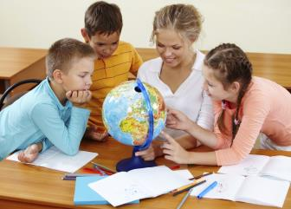
Teaching

Slide 12
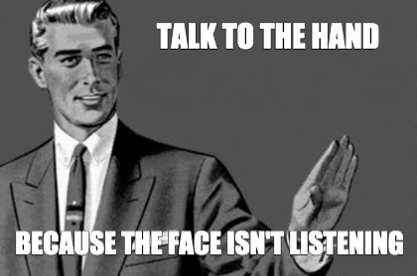
Reproof

Slide 13
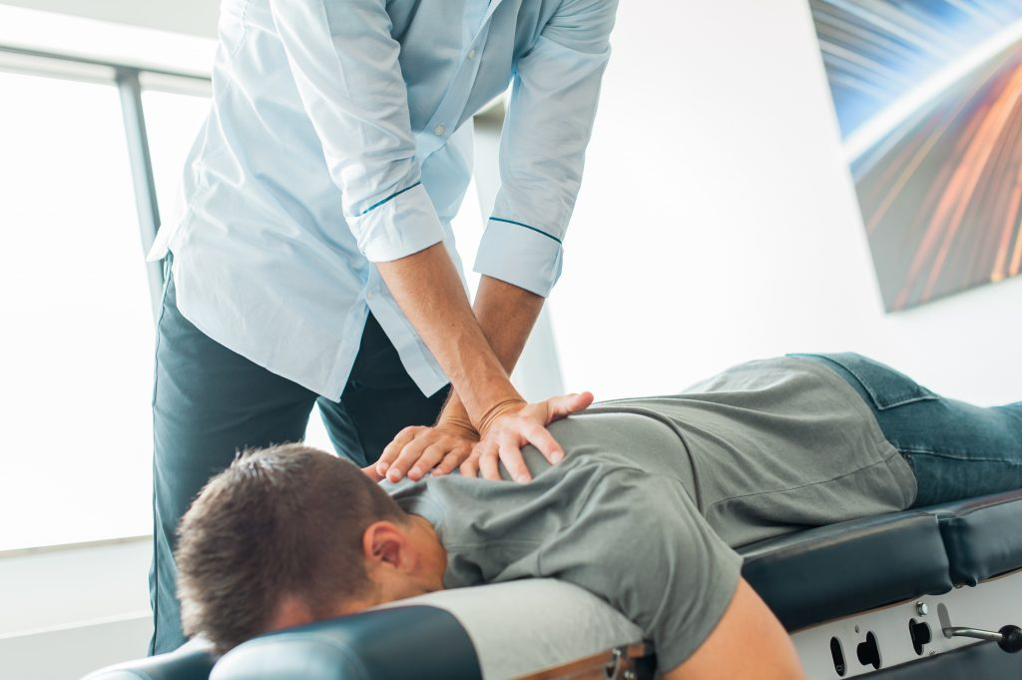
Correction

Slide 14
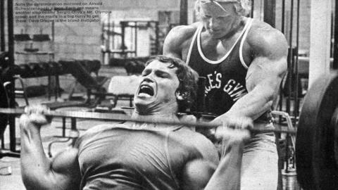
Discipline

Slide 15
“The Word of God I think of as a straight edge, which shows up our own crookedness. We can’t really tell how crooked our thinking is until we line it up with the straight edge of Scripture.”
- Elisabeth Elliot

