Slide 2
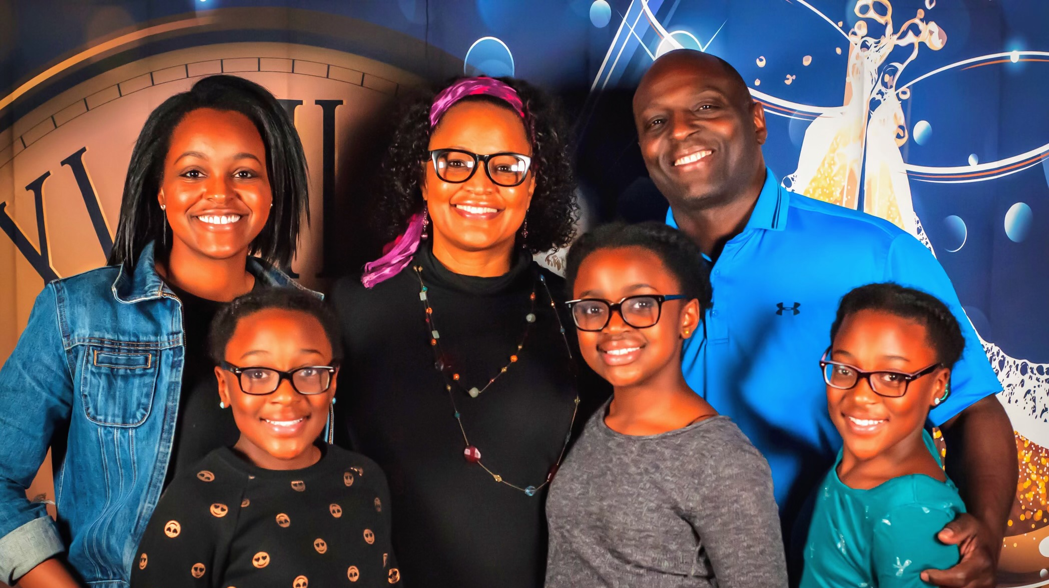

Slide 3
MEALS SCENES IN LUKE
Scripture | Meal | Participants
5:27-32 | Banquet at Levi’s House | Tax collectors and sinners
7:36-50 | Dinner at Simon’s House | Pharisees, guests and sinful woman
9:10-17 | Feeding the 5,000 | Disciples and Crowds
10:38-42 | *Hospitality at the home of Mary and Martha | Mary and Martha
11:37-52 | Dinner at a Pharisee’s House | Pharisees and Lawyers
14:1-24 | Sabbath Meal at a Pharisee’s House | Pharisees, Lawyers and Guests
19:1-10 * | Hospitality at the home of Zacchaeus | Zacchaeus
22:14-38 | The Last Supper | The Apostles
24:28-32 | Breaking Bread at Emmaus | Two Disciples
24:36-43 | Jesus Eats Meal in Presence of Disciples | Two Disciples
* This meal is implied in the narrative.

Slide 4
JESUS’ TABLE POLICY
“Jesus also went on to say to the one who had invited Him, “When you give a luncheon or a dinner, do not invite your friends or your brothers or your relatives or wealthy neighbors, otherwise they may also invite you in return and that will be your repayment.” Luke 14:12

Slide 5
MEALS/LACK OF MEALS SERVING AS LESSONS
The First Temptation of Jesus (4:1-4)
Question about Fasting (5:33-39)
Disciples Pluck Grain on Sabbath (6:1-5)
Mission of the Seventy (10:1-9)
Lord’s Prayer and Perseverance in Prayer (11:1-13)
Parable of Lost Son and Elder Brother (15:11-32)
The Rich Man and Lazarus (16:19-31)

Slide 6
HOSPITALITY
CONCESSION TO BROKENNESS
SETTING THE TABLE
THE SOCIAL REVOLUTION
BOUNDARIES TO HOSPITALITY

