Slide 1
Hang in there!

Slide 2
(18) "And to the angel of the church in Thyatira write: The Son of God, who has eyes like a flame of fire, and His feet are like burnished bronze, says this:
(19) 'I know your deeds, and your love and faith and service and perseverance, and that your deeds of late are greater than at first.

Slide 3
(20) 'But I have this against you, that you tolerate the woman Jezebel, who calls herself a prophetess, and she teaches and leads My bond-servants astray so that they commit acts of immorality and eat things sacrificed to idols.

Slide 4
(21) 'I gave her time to repent, and she does not want to repent of her immorality.
(22) 'Behold, I will throw her on a bed of sickness, and those who commit adultery with her into great tribulation, unless they repent of her deeds.

Slide 5
(23) 'And I will kill her children with pestilence, and all the churches will know that I am He who searches the minds and hearts; and I will give to each one of you according to your deeds.

Slide 6
(24) 'But I say to you, the rest who are in Thyatira, who do not hold this teaching, who have not known the deep things of Satan, as they call them—I place no other burden on you.
(25) 'Nevertheless what you have, hold fast until I come.

Slide 7
(26) 'He who overcomes, and he who keeps My deeds until the end, TO HIM I WILL GIVE AUTHORITY OVER THE NATIONS;
(27) AND HE SHALL RULE THEM WITH A ROD OF IRON, AS THE VESSELS OF THE POTTER ARE BROKEN TO PIECES, as I also have received authority from My Father;

Slide 8
(28) and I will give him the morning star.
(29) 'He who has an ear, let him hear what the Spirit says to the churches.'

Slide 9
Hang in there!

Slide 10
YOU ARE GROWING

Slide 11
(19) 'I know your deeds, and your love and faith and service and perseverance, and that your deeds of late are greater than at first.

Slide 12
2Pe 1:5-10
(5) Now for this very reason also, applying all diligence, in your faith supply moral excellence, and in your moral excellence, knowledge,

Slide 13
(6) and in your knowledge, self-control, and in your self-control, perseverance, and in your perseverance, godliness,
(7) and in your godliness, brotherly kindness, and in your brotherly kindness, love.

Slide 14
(8) For if these qualities are yours and are increasing, they render you neither useless nor unfruitful in the true knowledge of our Lord Jesus Christ.
(9) For he who lacks these qualities is blind or short-sighted, having forgotten his purification from his former sins.

Slide 15
(10) Therefore, brethren, be all the more diligent to make certain about His calling and choosing you; for as long as you practice these things, you will never stumble;

Slide 16
1Pe 2:2-3
(2) like newborn babies, long for the pure milk of the word, so that by it you may grow in respect to salvation,
(3) if you have tasted the kindness of the Lord.

Slide 17
2Pe 3:17-18
(17) You therefore, beloved, knowing this beforehand, be on your guard so that you are not carried away by the error of unprincipled men and fall from your own steadfastness,
(18) but grow in the grace and knowledge of our Lord and Savior Jesus Christ. To Him be the glory, both now and to the day of eternity. Amen.

Slide 18
YOU WILL TOLERATE

Slide 19
(20) 'But I have this against you, that you tolerate the woman Jezebel, who calls herself a prophetess, and she teaches and leads My bond-servants astray so that they commit acts of immorality and eat things sacrificed to idols.
(21) 'I gave her time to repent, and she does not want to repent of her immorality.

Slide 20
1Ki 21:25-26
(25) Surely there was no one like Ahab who sold himself to do evil in the sight of the LORD, because Jezebel his wife incited him.
(26) He acted very abominably in following idols, according to all that the Amorites had done, whom the LORD cast out before the sons of Israel.

Slide 21
Act 20:28-31
(28) "Be on guard for yourselves and for all the flock, among which the Holy Spirit has made you overseers, to shepherd the church of God which He purchased with His own blood.
(29) "I know that after my departure savage wolves will come in among you, not sparing the flock;

Slide 22
(30) and from among your own selves men will arise, speaking perverse things, to draw away the disciples after them.
(31) "Therefore be on the alert, remembering that night and day for a period of three years I did not cease to admonish each one with tears.

Slide 23
IT’S GONNA GET WORSE

Slide 24
(25) 'Nevertheless what you have, hold fast until I come.
(26) 'He who overcomes, and he who keeps My deeds until the end, TO HIM I WILL GIVE AUTHORITY OVER THE NATIONS;

Slide 25
(18) "And to the angel of the church in Thyatira write: The Son of God, who has eyes like a flame of fire, and His feet are like burnished bronze, says this:

Slide 26
Luk 22:59-62
(59) After about an hour had passed, another man began to insist, saying, "Certainly this man also was with Him, for he is a Galilean too."
(60) But Peter said, "Man, I do not know what you are talking about." Immediately, while he was still speaking, a rooster crowed.

Slide 27
(61) The Lord turned and looked at Peter. And Peter remembered the word of the Lord, how He had told him, "Before a rooster crows today, you will deny Me three times."
(62) And he went out and wept bitterly.

Slide 28
Rev 1:15
(15) His feet were like burnished bronze, when it has been made to glow in a furnace, and His voice was like the sound of many waters.

Slide 29
1Pe 1:6-9
(6) In this you greatly rejoice, even though now for a little while, if necessary, you have been distressed by various trials,
(7) so that the proof of your faith, being more precious than gold which is perishable, even though tested by fire, may be found to result in praise and glory and honor at the revelation of Jesus Christ;

Slide 30
(8) and though you have not seen Him, you love Him, and though you do not see Him now, but believe in Him, you greatly rejoice with joy inexpressible and full of glory,
(9) obtaining as the outcome of your faith the salvation of your souls.

Slide 31
Rev 1:1
(1) The Revelation of Jesus Christ, which God gave Him to show to His bond-servants, the things which must soon take place; and He sent and communicated it by His angel to His bond-servant John,

Slide 32
Rev 1:3
(3) Blessed is he who reads and those who hear the words of the prophecy, and heed the things which are written in it; for the time is near.

Slide 33
Rev 1:19
(19) "Therefore write the things which you have seen, and the things which are, and the things which will take place after these things.

Slide 34
Rev 4:1
(1) After these things I looked, and behold, a door standing open in heaven, and the first voice which I had heard, like the sound of a trumpet speaking with me, said, "Come up here, and I will show you what must take place after these things."

Slide 35
Rev 22:6
(6) And he said to me, "These words are faithful and true"; and the Lord, the God of the spirits of the prophets, sent His angel to show to His bond-servants the things which must soon take place.

Slide 36
Rev 22:10
(10) And he said to me, "Do not seal up the words of the prophecy of this book, for the time is near.

Slide 37
Rev 6:2
(2) I looked, and behold, a white horse, and he who sat on it had a bow; and a crown was given to him, and he went out conquering and to conquer.

Slide 38
Rev 6:3-4
(3) When He broke the second seal, I heard the second living creature saying, "Come."
(4) And another, a red horse, went out; and to him who sat on it, it was granted to take peace from the earth, and that men would slay one another; and a great sword was given to him.

Slide 39
Rev 6:5-6
(5) When He broke the third seal, I heard the third living creature saying, "Come." I looked, and behold, a black horse; and he who sat on it had a pair of scales in his hand.
(6) And I heard something like a voice in the center of the four living creatures saying, "A quart of wheat for a denarius, and three quarts of barley for a denarius; and do not damage the oil and the wine."

Slide 40
Rev 6:7-8
(7) When the Lamb broke the fourth seal, I heard the voice of the fourth living creature saying, "Come."
(8) I looked, and behold, an ashen horse; and he who sat on it had the name Death; and Hades was following with him. Authority was given to them over a fourth of the earth, to kill with sword and with famine and with pestilence and by the wild beasts of the earth.

Slide 41
Rev 6:9-11
(9) When the Lamb broke the fifth seal, I saw underneath the altar the souls of those who had been slain because of the word of God, and because of the testimony which they had maintained;

Slide 42
(10) and they cried out with a loud voice, saying, "How long, O Lord, holy and true, will You refrain from judging and avenging our blood on those who dwell on the earth?"

Slide 43
(11) And there was given to each of them a white robe; and they were told that they should rest for a little while longer, until the number of their fellow servants and their brethren who were to be killed even as they had been, would be completed also.

Slide 44
Heb 10:31-39
(31) It is a terrifying thing to fall into the hands of the living God.
(32) But remember the former days, when, after being enlightened, you endured a great conflict of sufferings,

Slide 45
(33) partly by being made a public spectacle through reproaches and tribulations, and partly by becoming sharers with those who were so treated.
(34) For you showed sympathy to the prisoners and accepted joyfully the seizure of your property, knowing that you have for yourselves a better possession and a lasting one.

Slide 46
(35) Therefore, do not throw away your confidence, which has a great reward.
(36) For you have need of endurance, so that when you have done the will of God, you may receive what was promised.
(37) FOR YET IN A VERY LITTLE WHILE, HE WHO IS COMING WILL COME, AND WILL NOT DELAY.

Slide 47
(38) BUT MY RIGHTEOUS ONE SHALL LIVE BY FAITH; AND IF HE SHRINKS BACK, MY SOUL HAS NO PLEASURE IN HIM.
(39) But we are not of those who shrink back to destruction, but of those who have faith to the preserving of the soul.

Slide 48
Rev 2:28 and I will give him the morning star.

Slide 49
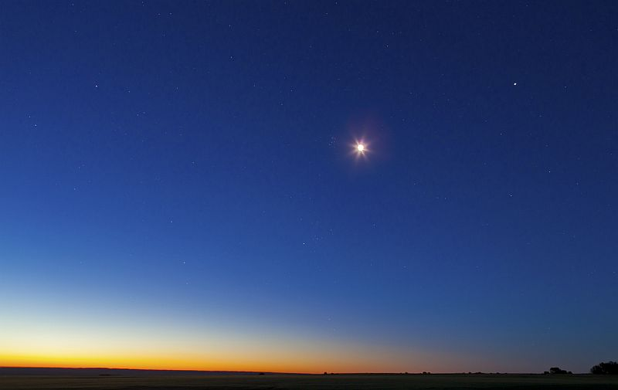

Slide 50
Hang in there!

