Slide 1

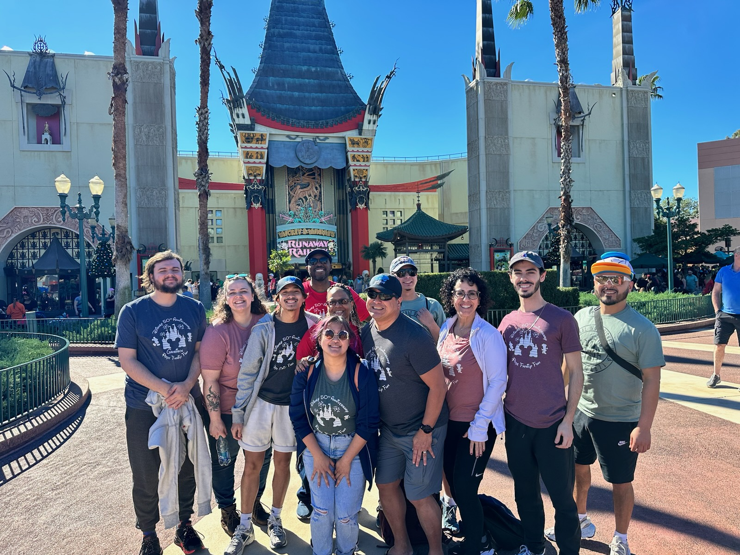



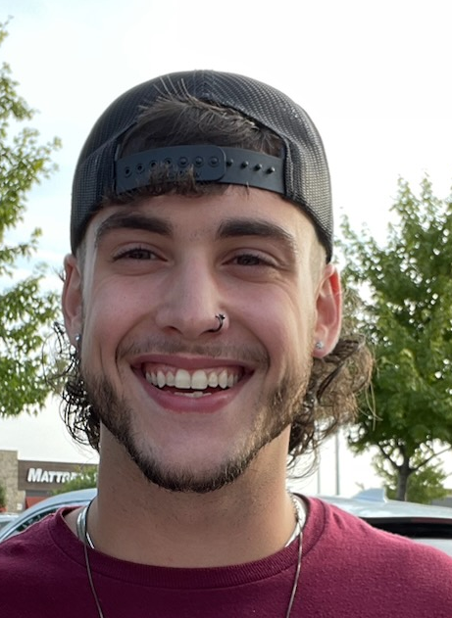
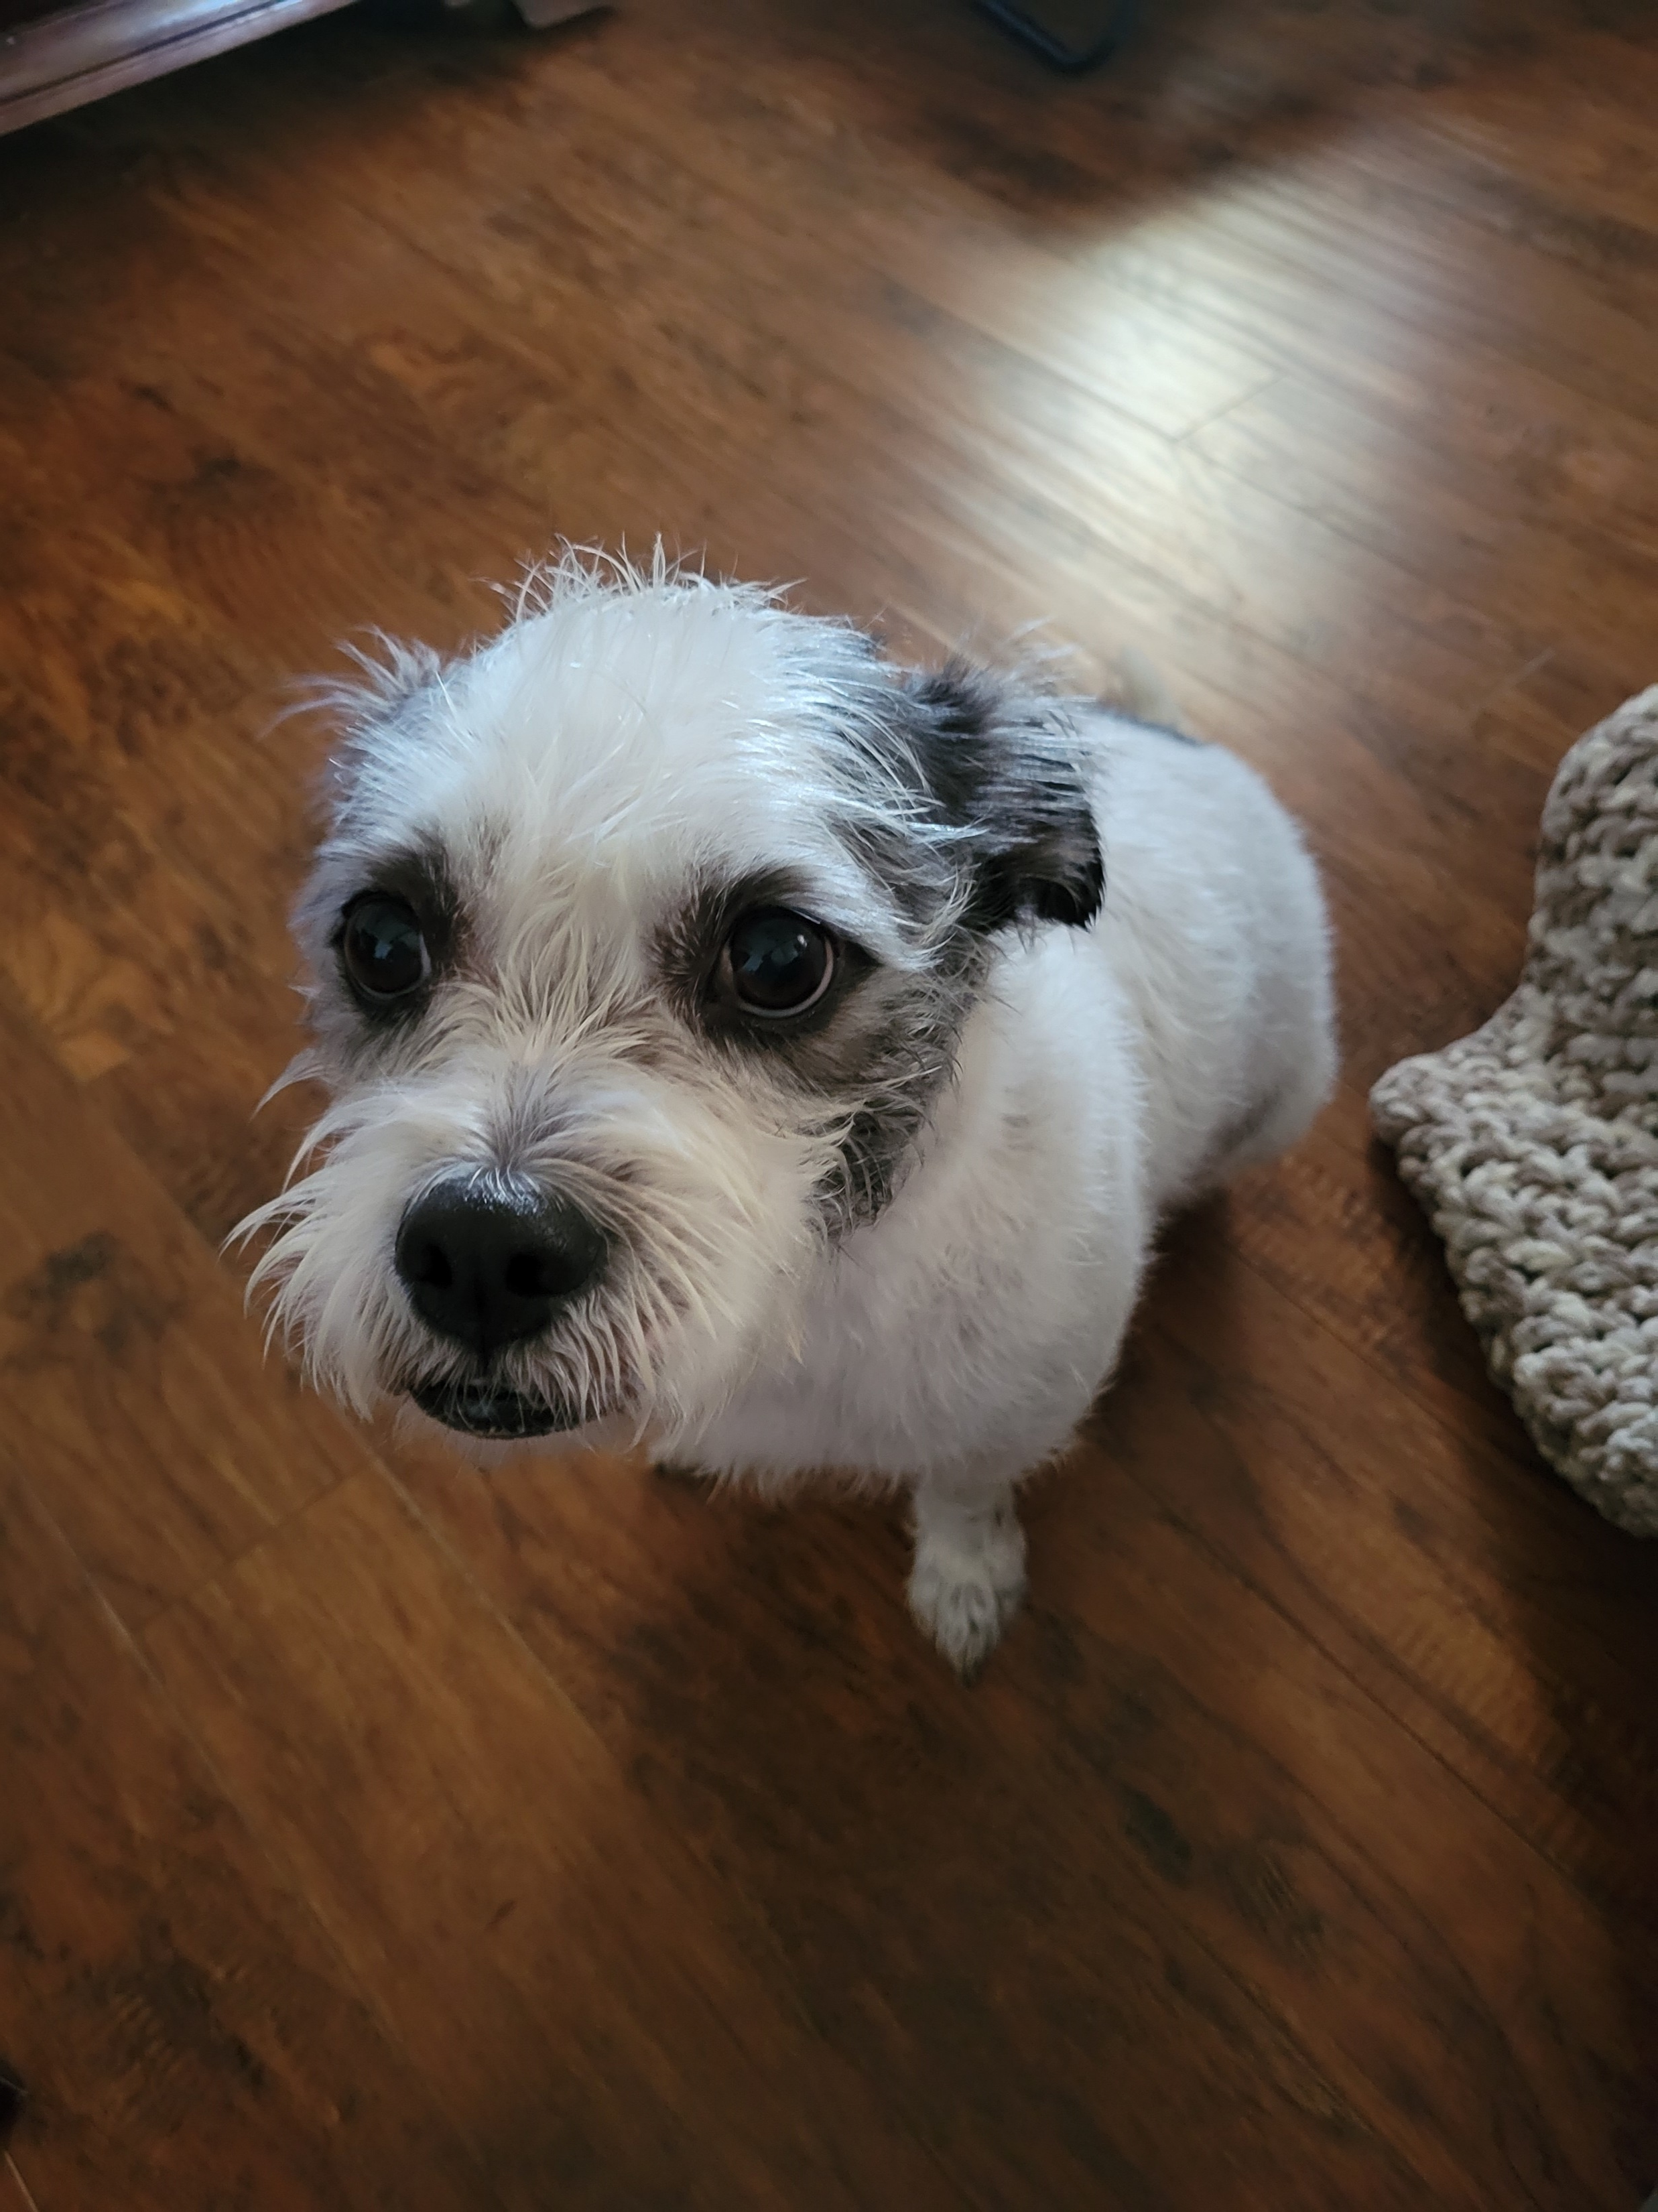
Ed Pope
OKC Church

Slide 2
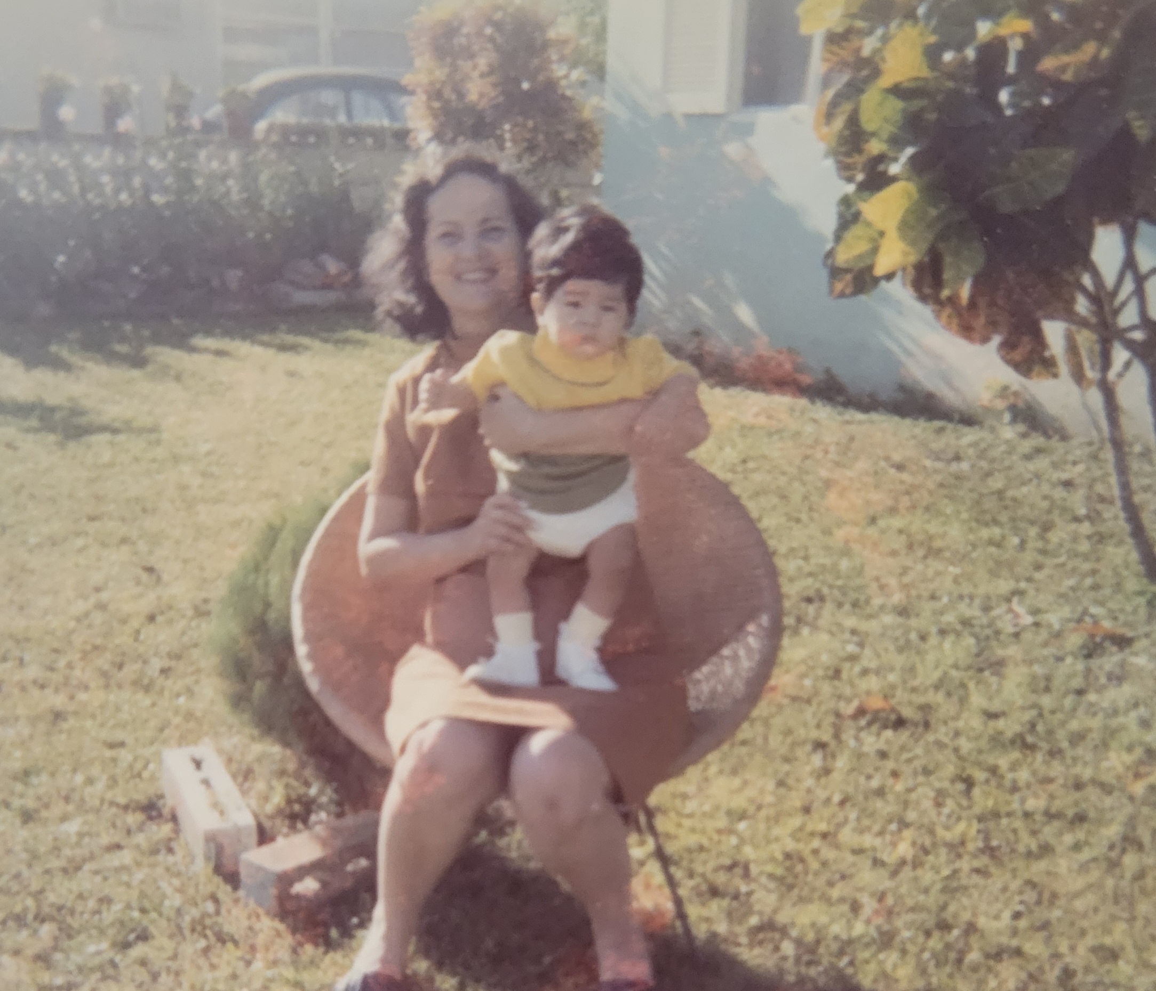
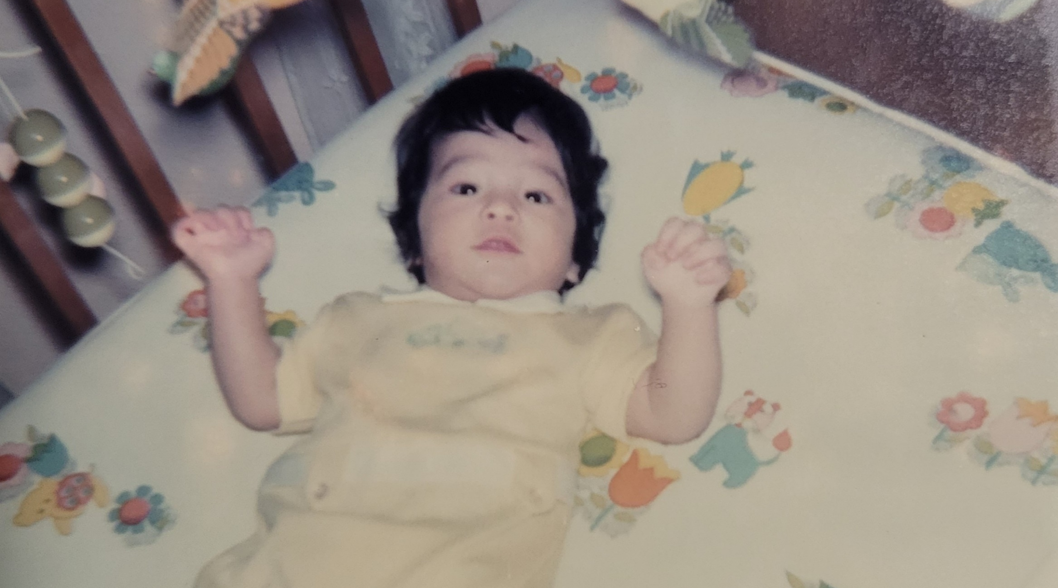
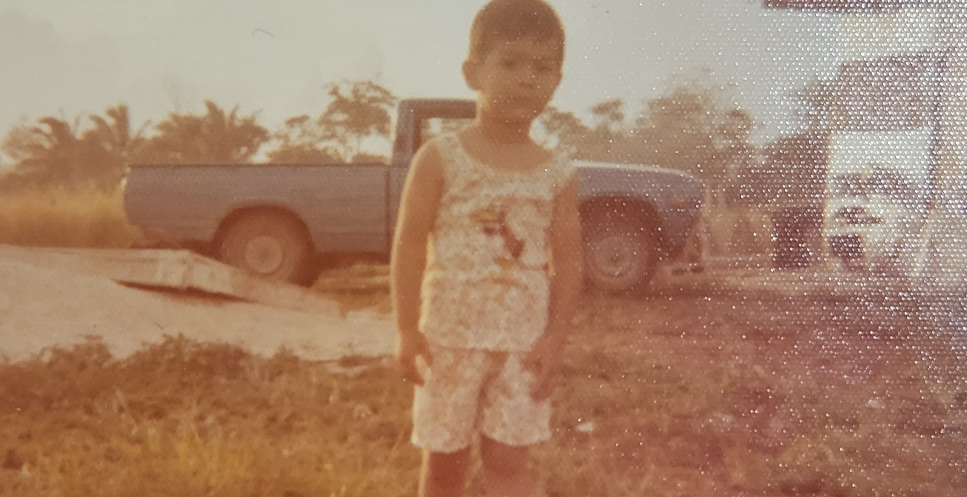
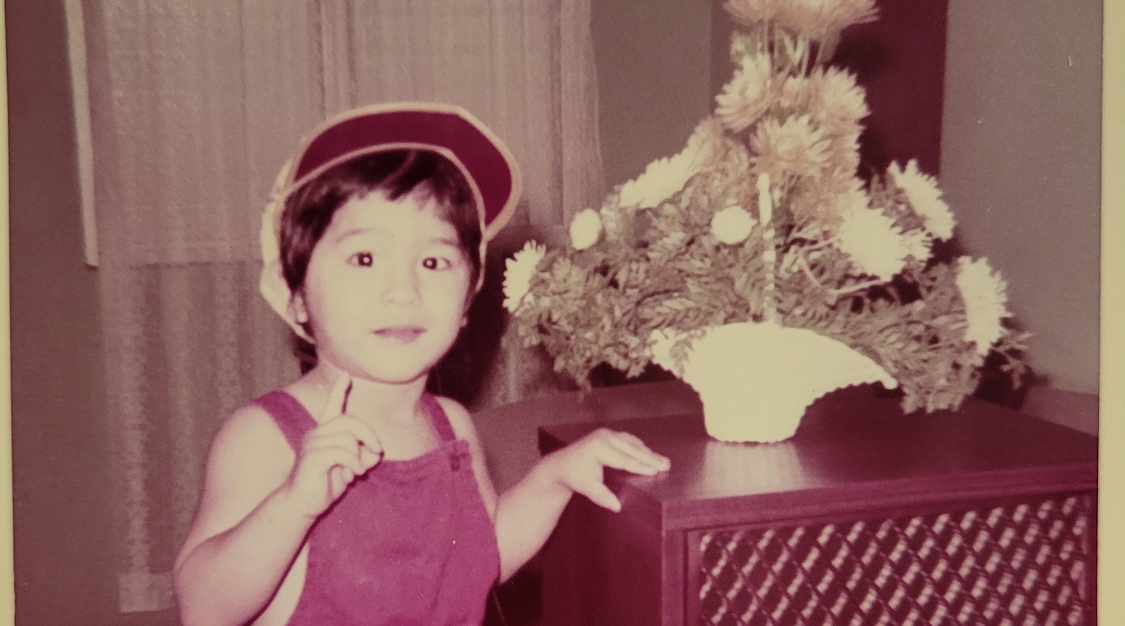

Slide 3
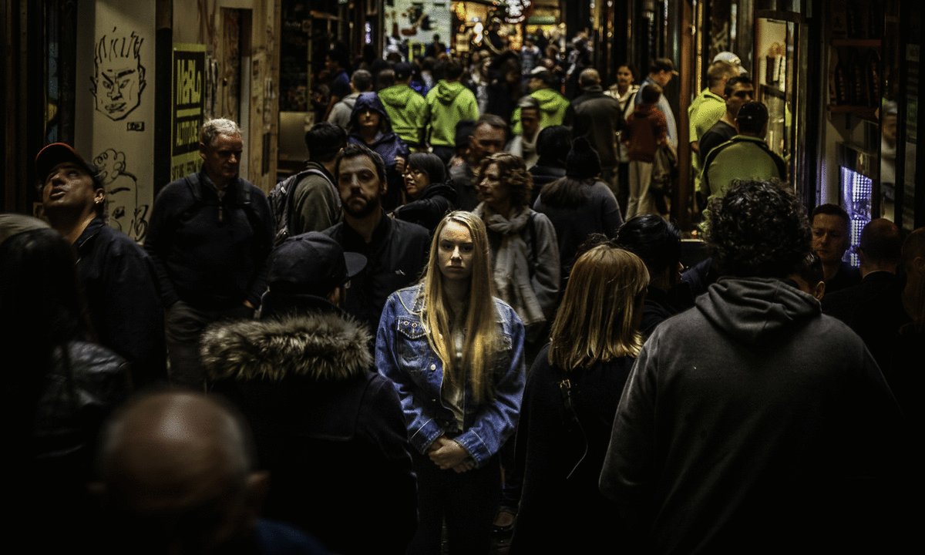
Alone in a crowded room

Slide 4

It’s Not good for man to be alone.
Genesis 2:18

Slide 5
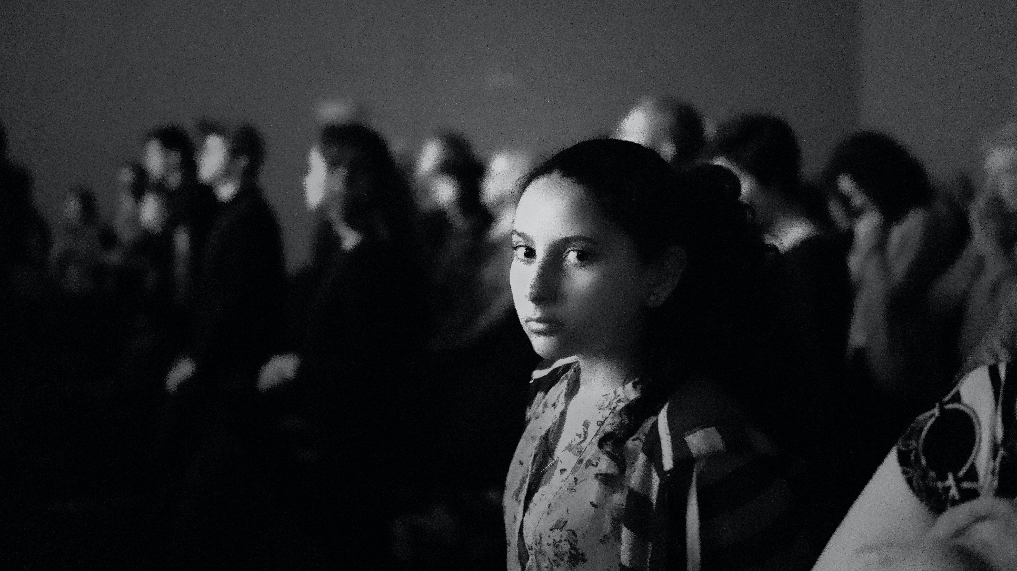
Where are you?

Slide 6



Slide 7

So let the sun come streaming in
'Cause you'll reach up and you'll rise again Lift your head and look around
You will be found

